Slide 1
Credit Card Fraud
Christopher Broll & Joseph Haaga

Slide 2
Problem introduction
Credit card fraud cost $16billion in 2016
This cost is often passed on to the consumer

Slide 3
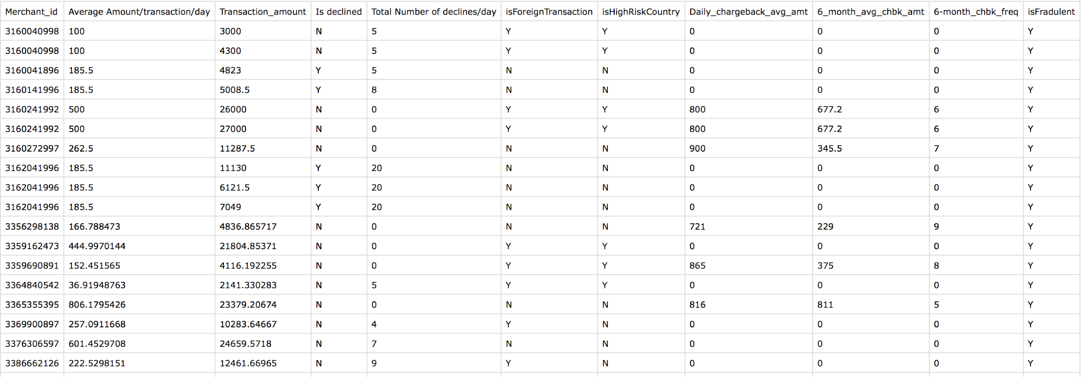
The data

Slide 4
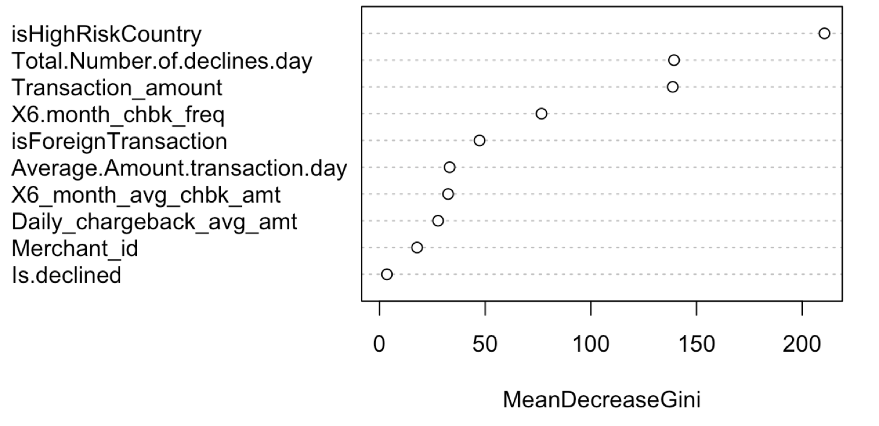
Feature Importances
Use Random Forest to view the importance of each feature

Slide 5
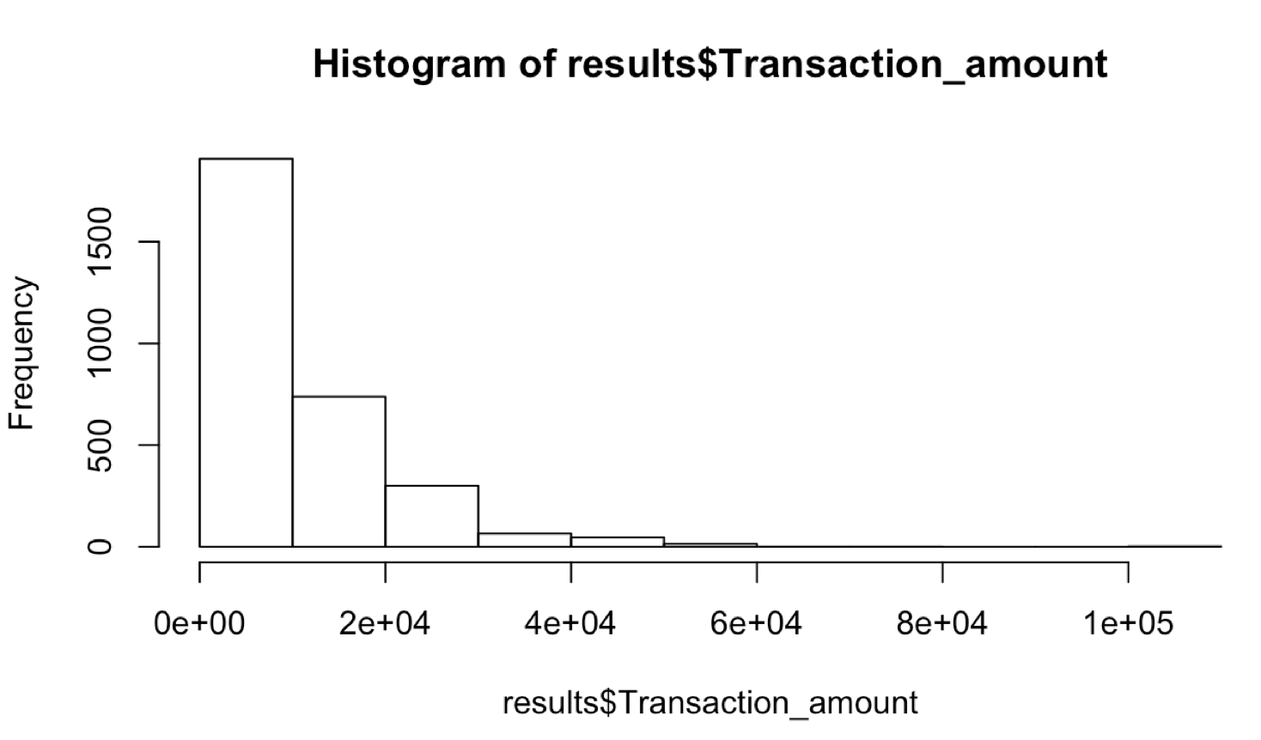

Slide 6
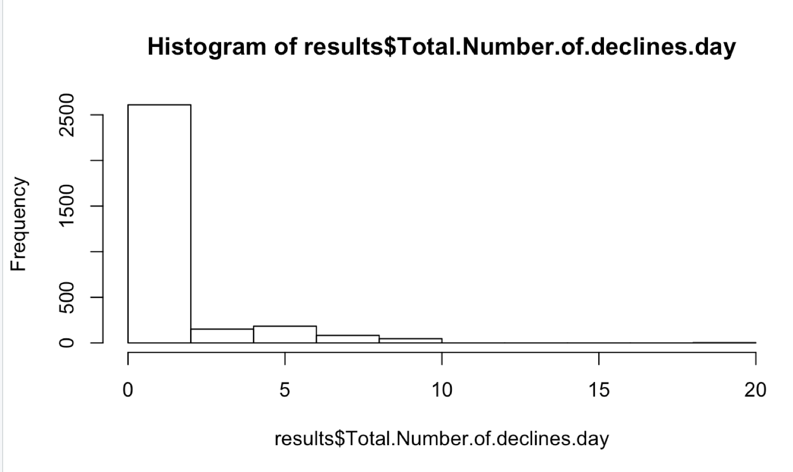

Slide 7
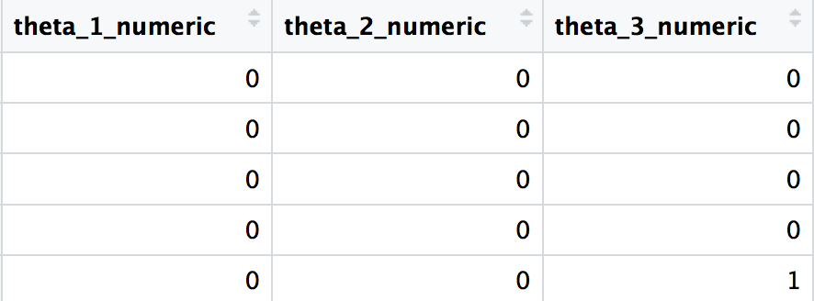
Formatting the data for MCMC
amount <= $3,974.215
$3,974.215 < amount <= $11,700.54
$11,700.54 < amount

Slide 8
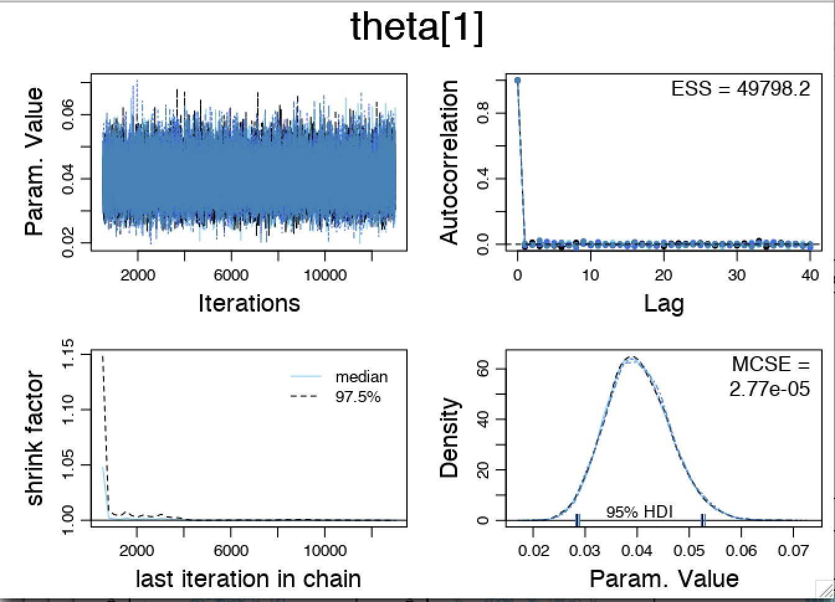

Slide 9


Slide 10
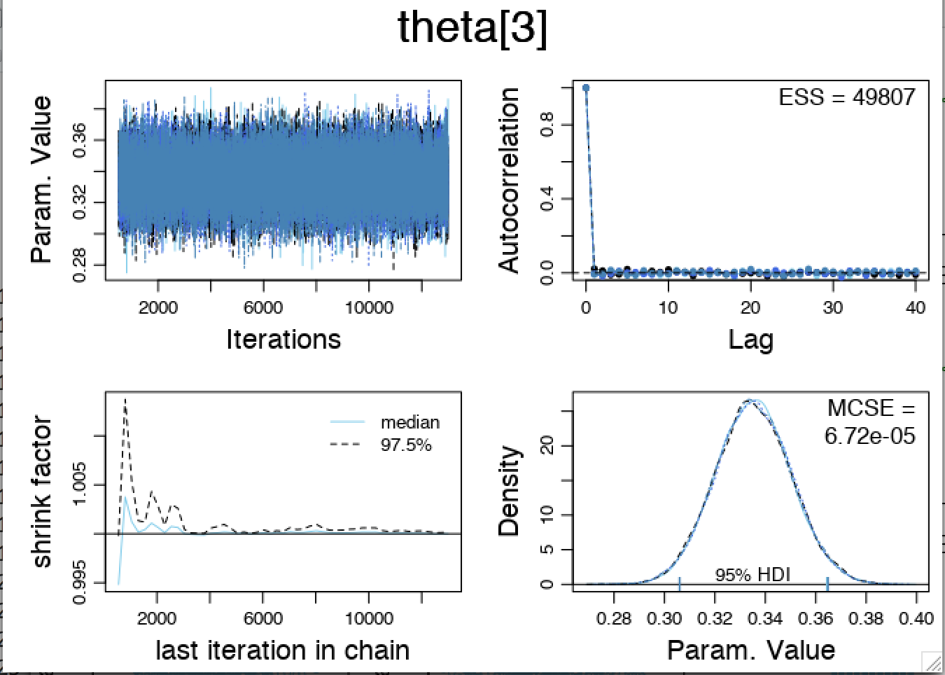

Slide 11
